Slide 1
Proposal for Redesigned Hospital Network
Austin Bell
James Driscoll
Mauricio Trejo

Slide 2
Network
Current
Proposed

Slide 3
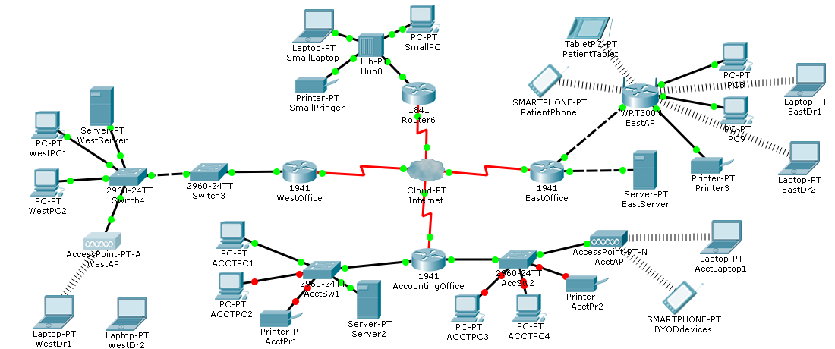
Current Network
Notes:
This is your current network. Unstable and no security. We will look at each office individually

Slide 4
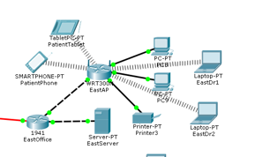
Current Network East Office
Notes:
Both patient Wi-Fi and doctors Wi-Fi using same router. HIPAA violation because the router does not allow for segregation.

Slide 5
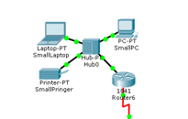
Current Network Small Office
Notes:
Only issue here is the non-configurable Hub. Does not allow for any type of security.

Slide 6
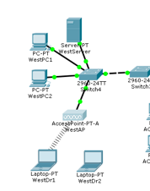
Current Network West Office
Notes:
This part of the network as with the others unreliable as evidence by one of the laptops not communicating with the Access Point. Also, no security of any kind.

Slide 7
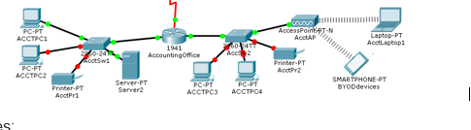
Current Network Accounting Office
Notes:
Finally, Accounting. As with the other three offices. This network is unreliable and there is no security setup.

Slide 8
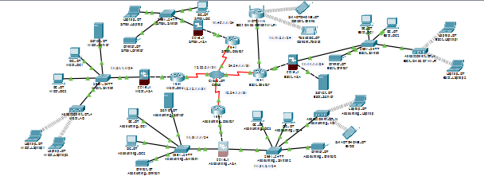
Proposed Network
Notes:
Now we will look at the proposed network. I don’t know if you can tell, but all the arrows are green meaning it is reliable, and all wireless devices communicate. Plus, there is a Firewall for each office. As before we will look at each office individually.

Slide 9
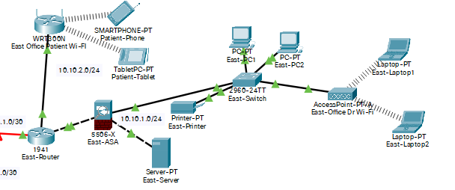
Proposed Network East Office
Notes:
First, starting with the East Office. As you can see, we added a Firewall for security, and we segregated the patient Wi-Fi and the doctors Wi-Fi. By placing the patient Wi-Fi outside the Firewall, the patients will only have access to the internet and not the rest of the network.

Slide 10
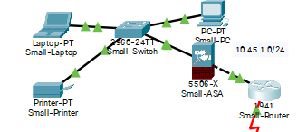
Proposed Network Small Office
Notes:
Next is the Small office. Again, there is a Firewall for security. Plus, we replaced the non-configurable Hub with a switch. As you can see, everything communicates.

Slide 11
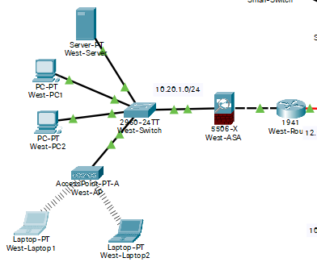
Proposed Network West Office
Notes:
Moving on to the West office. If you remember, there were times that the laptops would disconnect. That was solved by replacing the wireless adapters to the correct ones. As with the other offices, there is a Firewall to keep out unwanted traffic.

Slide 12
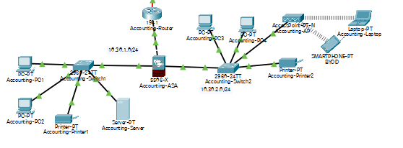
Proposed Network Accounting Office
Notes:
Finally, we have Accounting. As with the other offices, all green arrows. The wireless devices communicate and there is a firewall keeping out unwanted traffic.

